Slide 1
Predicting Amazon Rating Using Spark ML and Azure ML
Aakanksha Tasgaonkar
Amogh Mahesh
Monika Mishra
Professor – Dr. Jongwook Woo

Slide 2
Introduction
Rating helps customers to obtain useful information of products more easily and more efficiently.
Prediction of rating is important for the business to take corrective measures.
Recommendation systems are an important units in today's e-commerce applications, such as targeted advertising, personalized marketing and information retrieval.
Our goal is to predict ratings using various model.

Slide 3

ABOUT THE DATASET
Dataset URL : - https://s3.amazonaws.com/amazon-reviews-pds/tsv/amazon_reviews_multilingual_US_v1_00.tsv.gz
Products reviewed between 2005 and 2015 in US
File Size : 3.63 GB
Number of rows : 6.93 Millions
Number of Columns : 15
Number of File : 1
File Format : TSV (Tab Separated Values)

Slide 4
FEATURES
Features
Label
marketplace | helpful_votes
customer_id | total_votes
review_id | vine
product_id | verified_purchase
product_parent | review_headline
product_title | review_body
product_category | review_date
star_rating

Slide 5


TECHNICAL SPECIFICATIONS
Free Workspace
10 GB storage
Single node
DataBricks Subscription
Cluster 5.2 (includes Apache Spark 2.4.0, Scala 2.11)
6 GB Memory, 0.88 Cores, 1 DBU
Python Version 3

Slide 6
ALGORITHMS USED
Azure ML
Matchbox Recommender
Decision Forest Regression
Boosted Decision Tree Regression
Spark ML
Collaborative Filtering
Text Analytics using Logistic Regression

Slide 7

Flowchart
Gathering Data
Data Preprocessing
Data Transformation
Data Split
Train and Test
Evaluate
AZURE ML

Slide 8
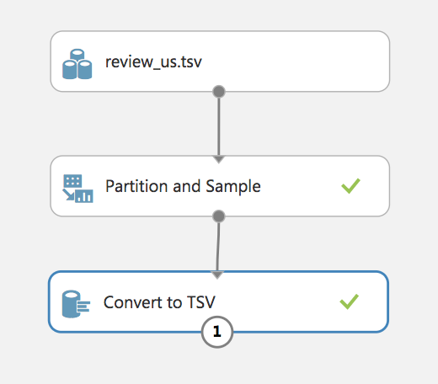
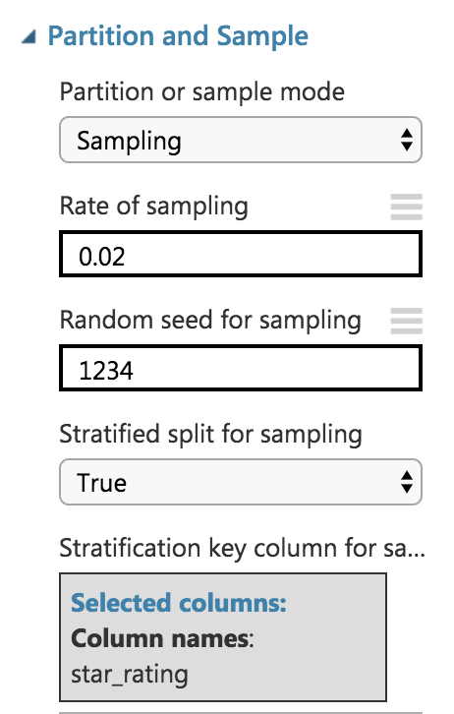
SAMPLING
Original Dataset : 3.63 GB
Sampled Dataset : 73 MB
Time Taken : 5.30 Minutes
Stratified Split ensures that the output dataset contains a representative sample of the values in the selected column.

Slide 9
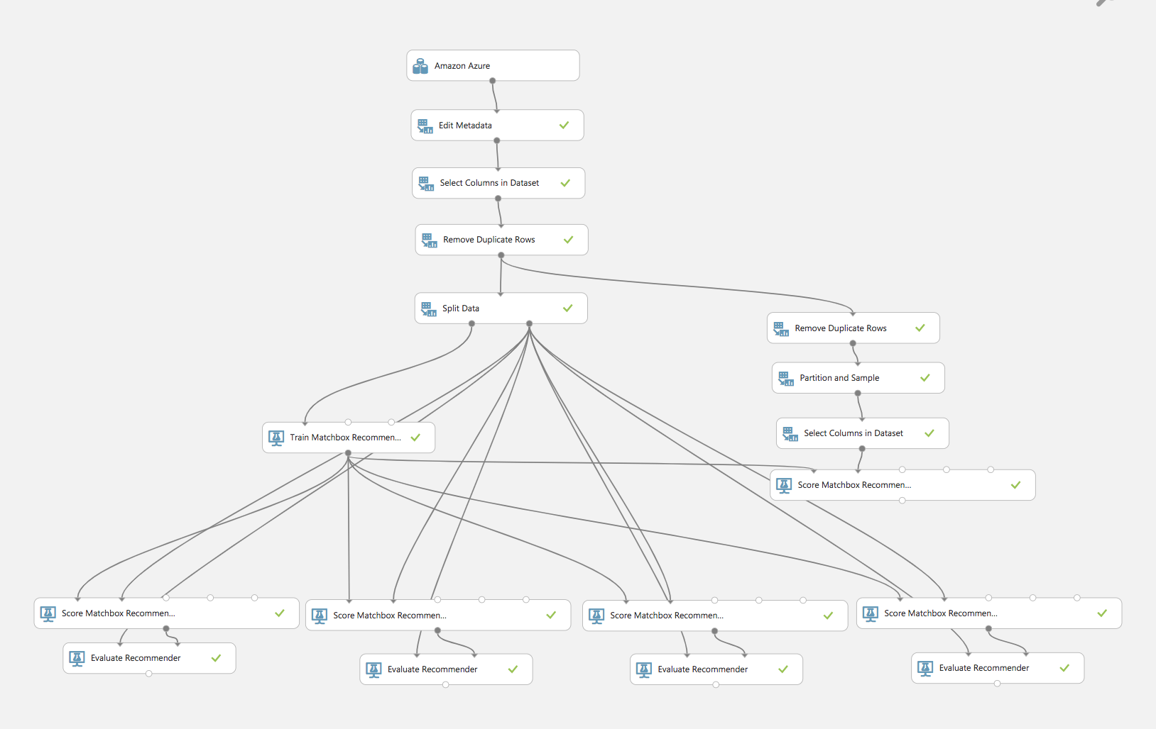
Matchbox Recommender
2% Sample
Time Taken : 6 Mins
75:25 Split Train/Test
Item Recommendation
Related Users
Rating Prediction
Related Items

Slide 10
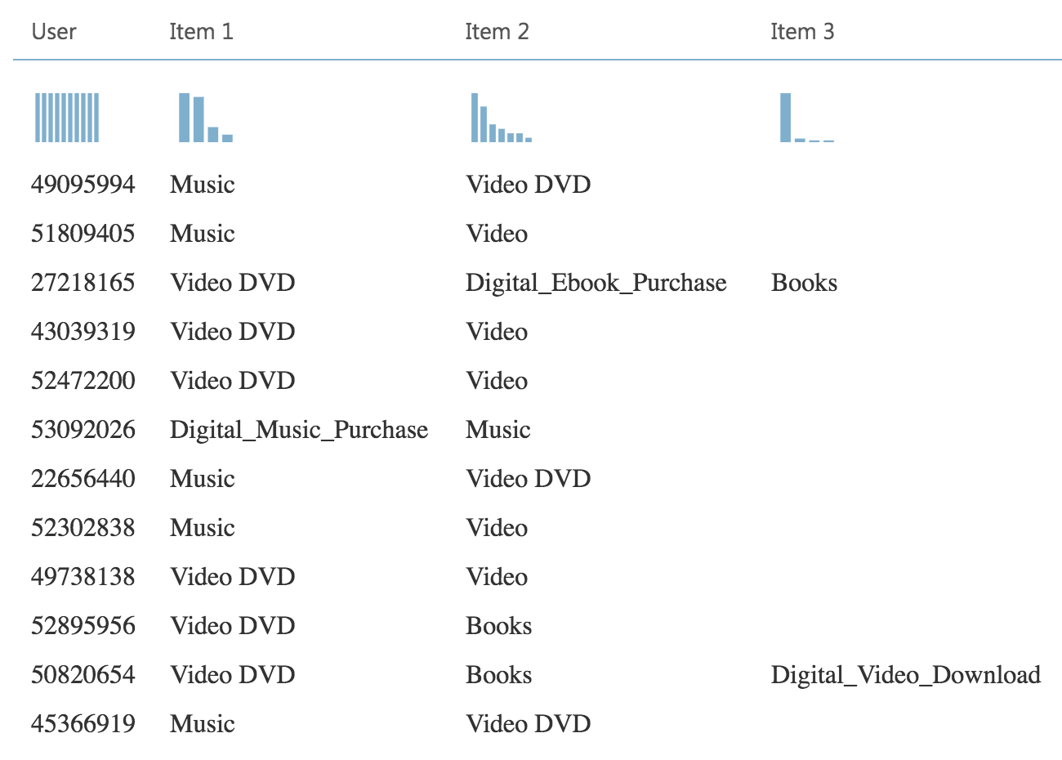
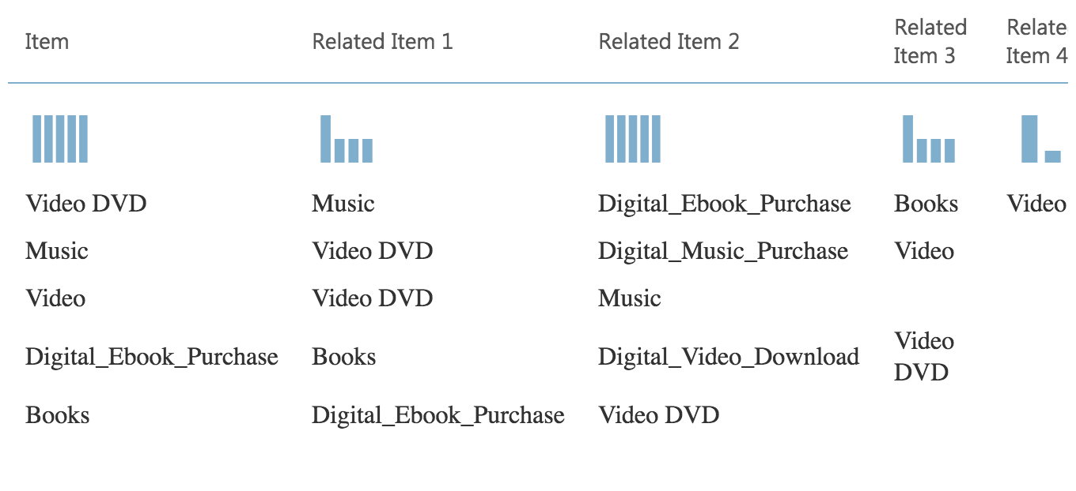
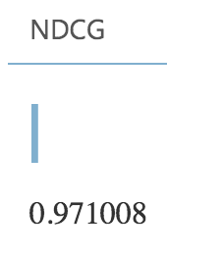
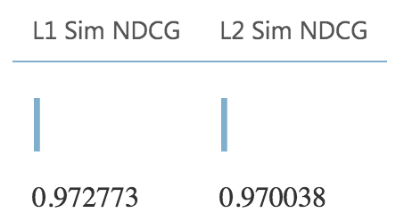
Matchbox Recommender Outcomes
Item Recommendation (From Rated Items) | Related Items (Categories)

Slide 11
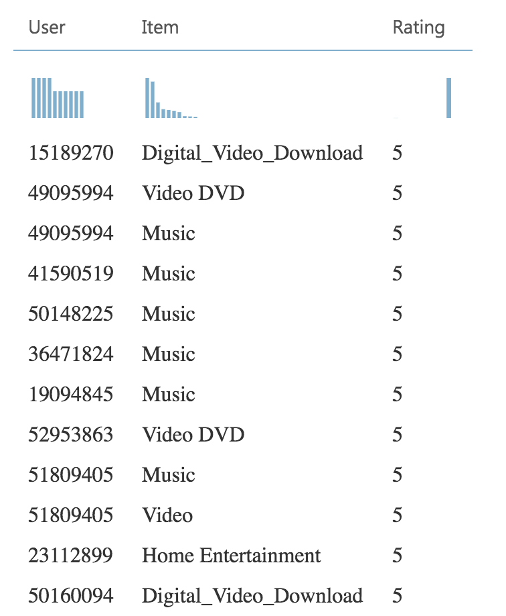
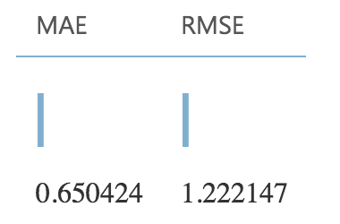
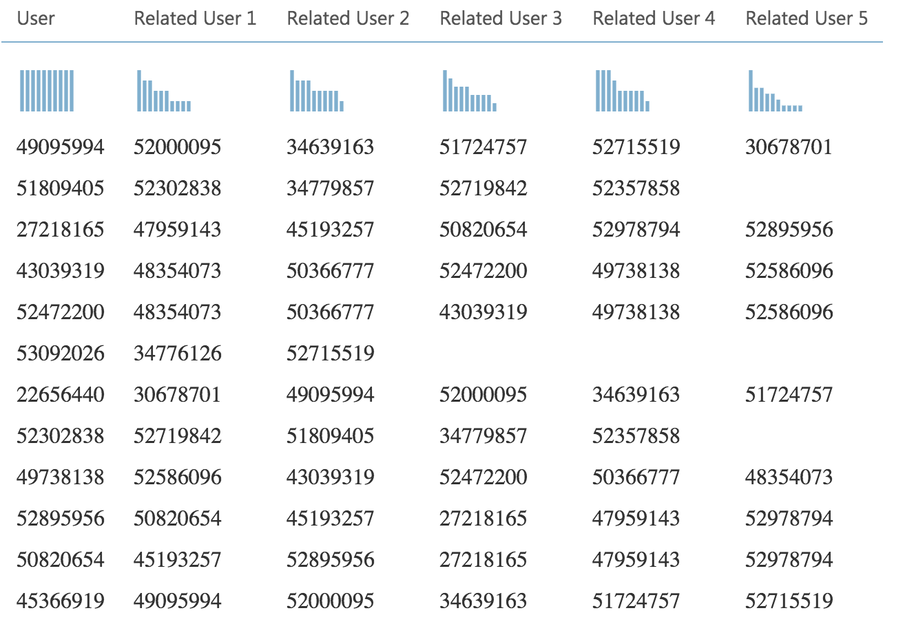
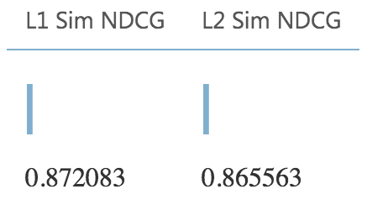
Matchbox Recommender Outcomes
Rating Prediction | Related Users

Slide 12
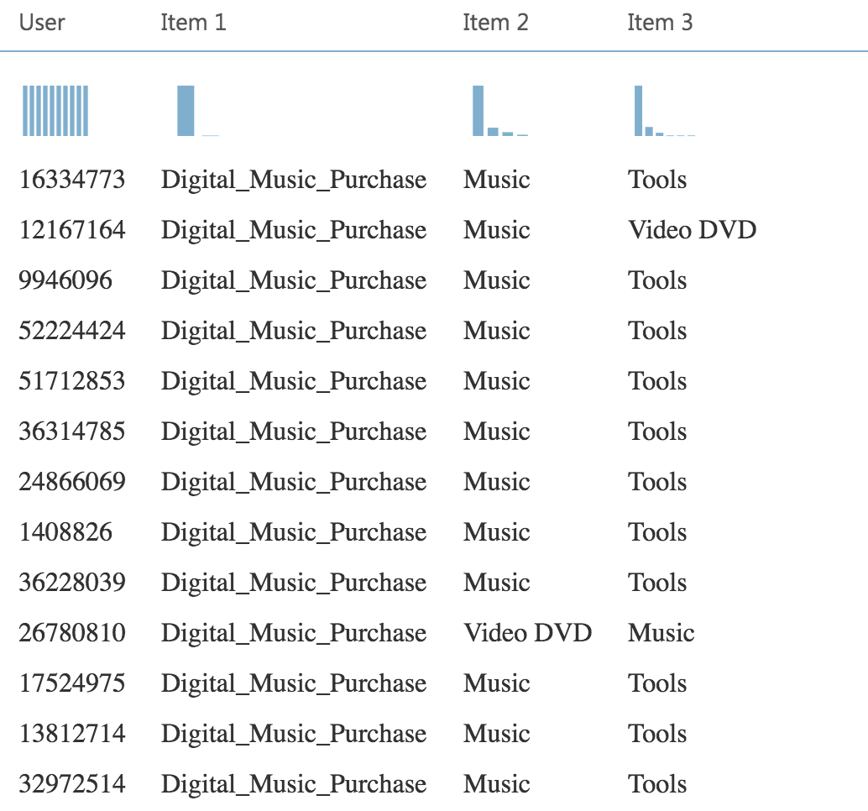
Matchbox Recommender Outcomes
Item Recommendation – From All Items

Slide 13
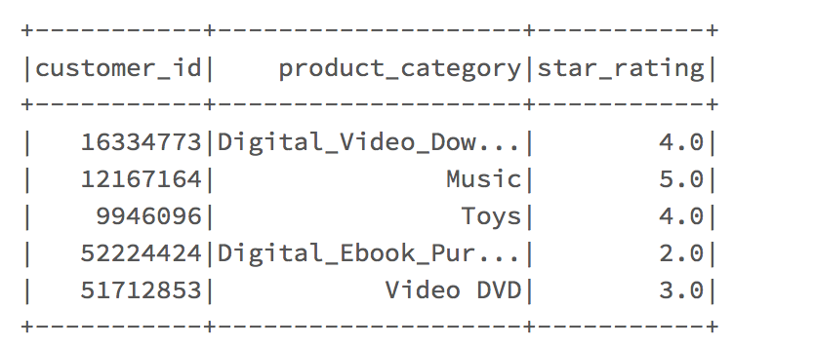
Collaborative Filtering Recommender
Selected the required columns from the cleaned data on the AzureML platform and uploaded in Databricks File System
Alternating Least Squares (ALS) algorithm * Explicit Feedback

Slide 14
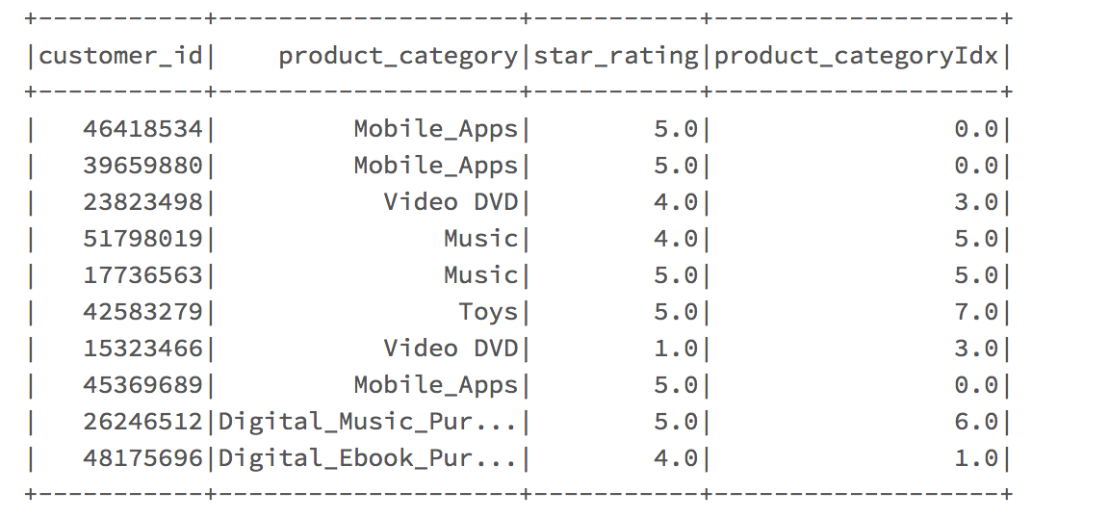
Collaborative Filtering Recommender
The ALS algorithm requires all three inputs in the integer form
StringIndexer Feature used to convert product category (string) into integer form

Slide 15
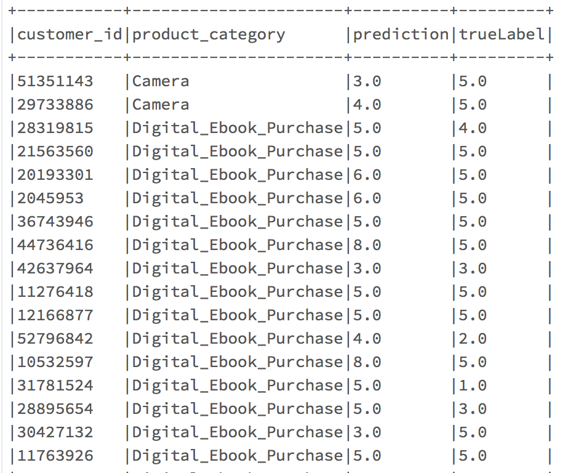
Collaborative Filtering Recommender
Time Taken : 30 Minutes

Slide 16
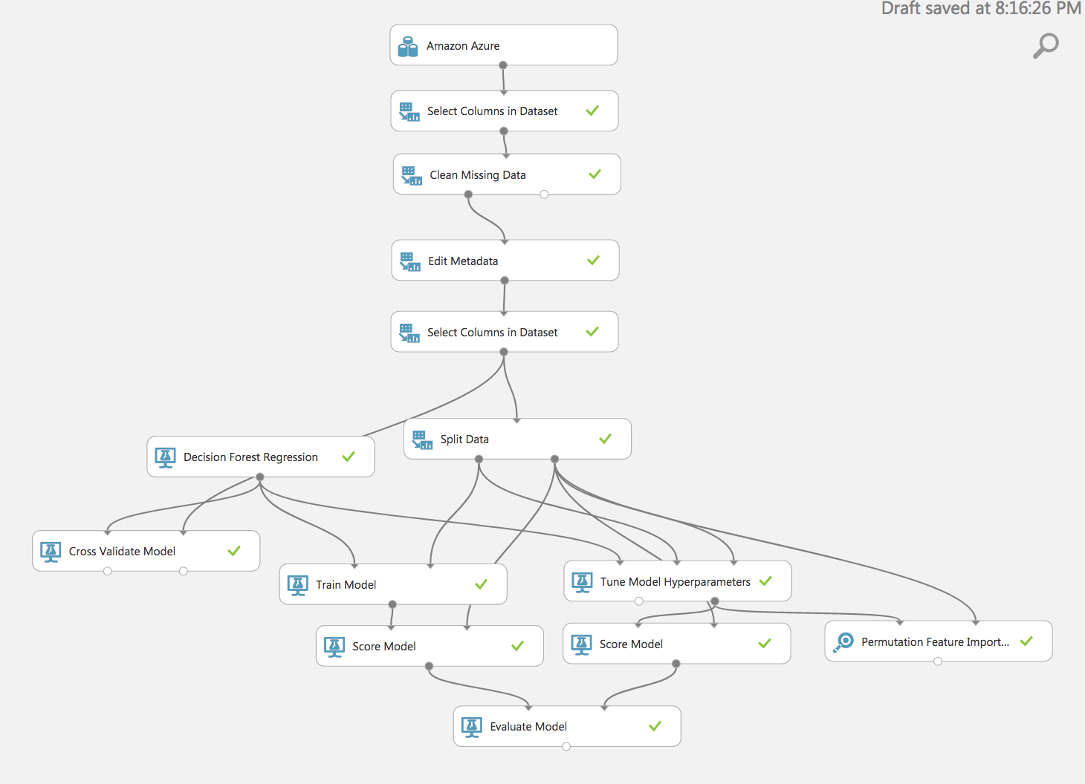
Decision Forest Regression
2% Sample
70:30 Split Train/Test
Cross-Validation
Tune Model Hyperparameters
Permutation Feature Importance
Time Taken: 30 Mins

Slide 17
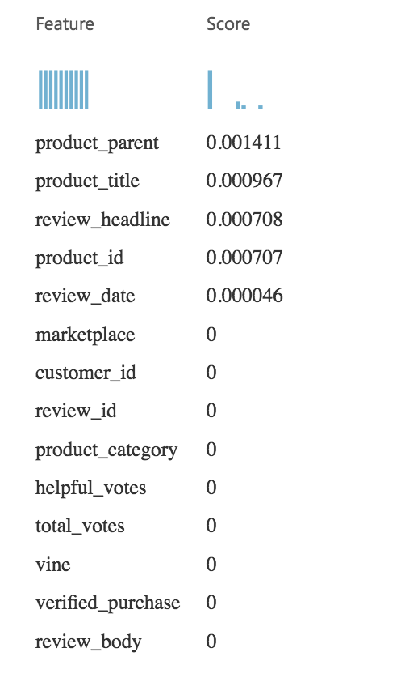
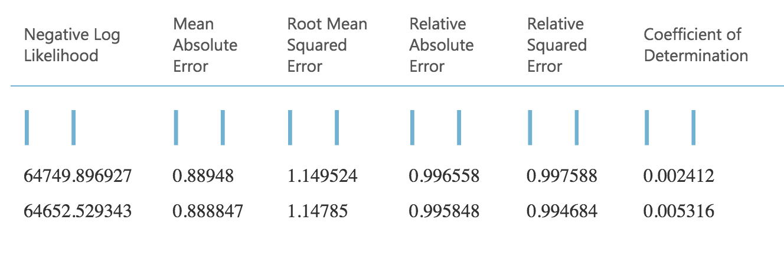
Decision Forest Regression
Evaluation Metrics
Permutation Feature

Slide 18
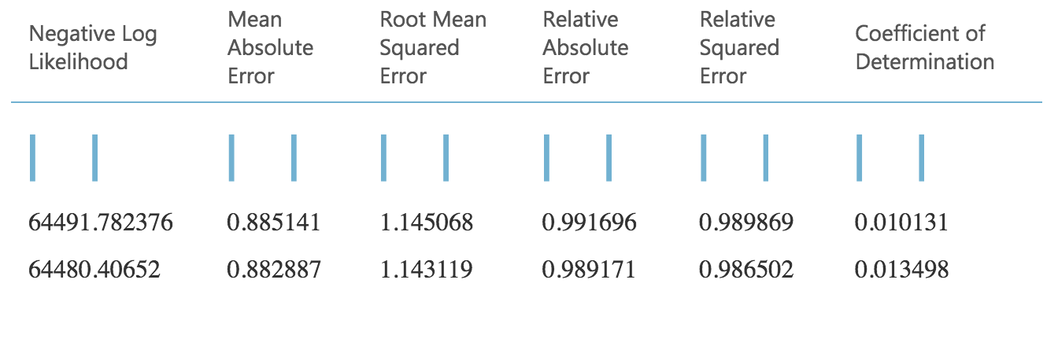
Decision Forest Regression
Features used:
product_parent
product_title
review_headline,
product_id
review_date
Evaluation Metrics
RMSE decreased but not a very significant difference

Slide 19
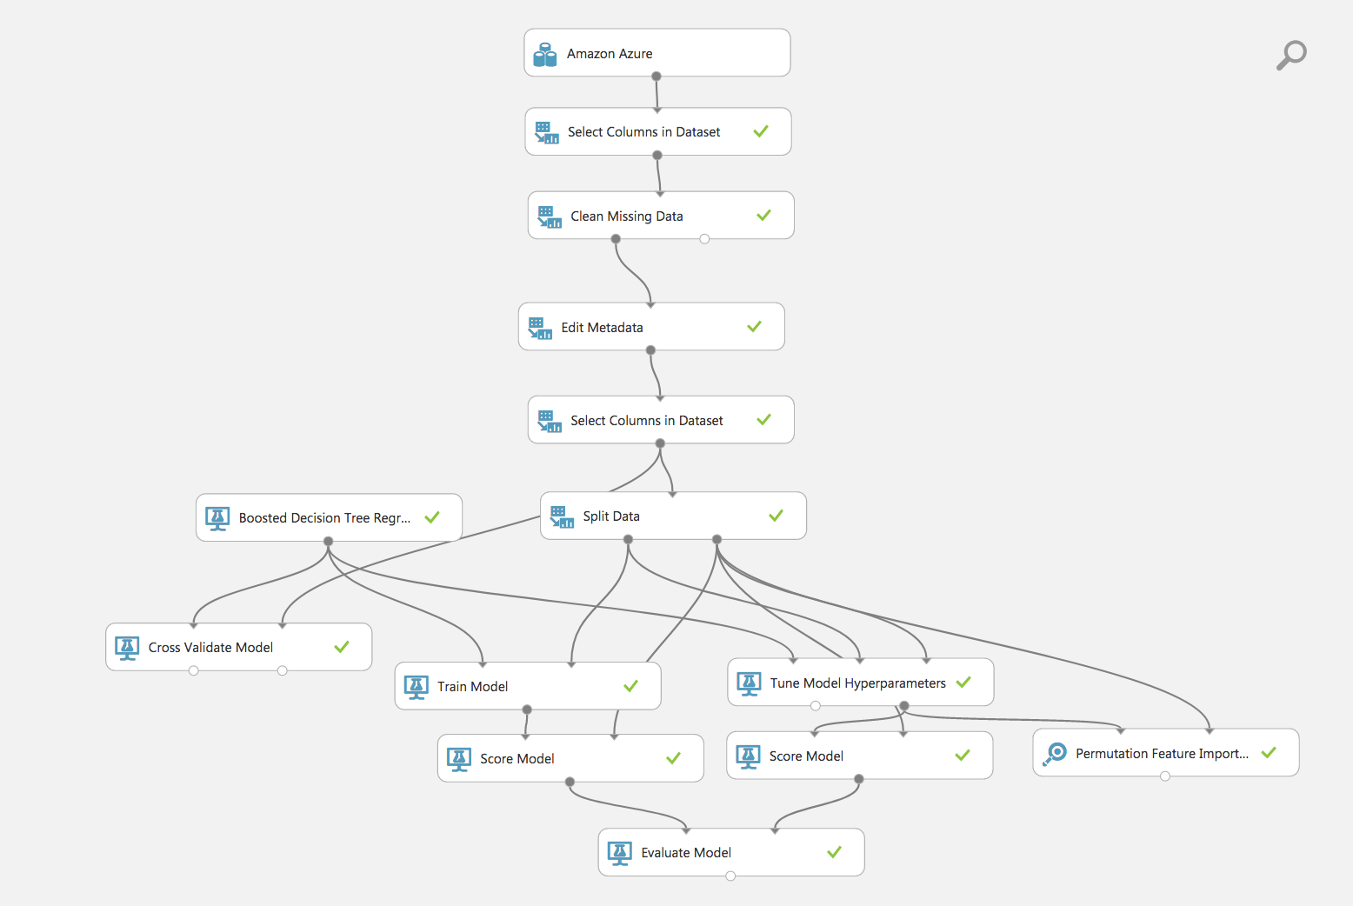
Boosted Decision Tree Regression
2% Sample
70:30 Split Train/Test
Cross-Validation
Tune Model Hyperparameters
Permutation Feature Importance
Time Taken: 1 hour 30 Minutes

Slide 20
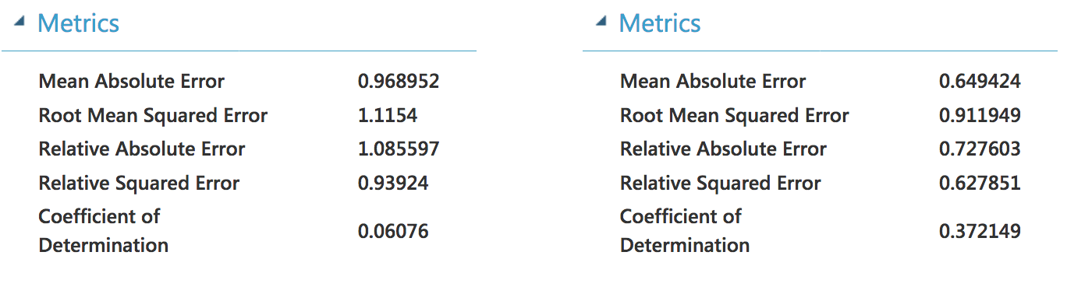
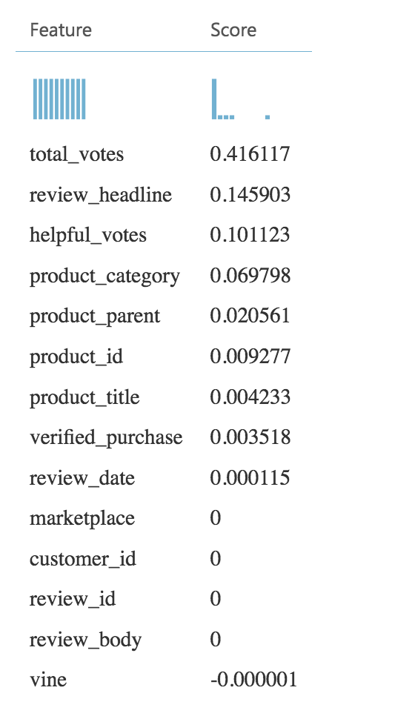
Boosted Decision Tree Regression
Evaluation Metrics
Permutation Feature

Slide 21
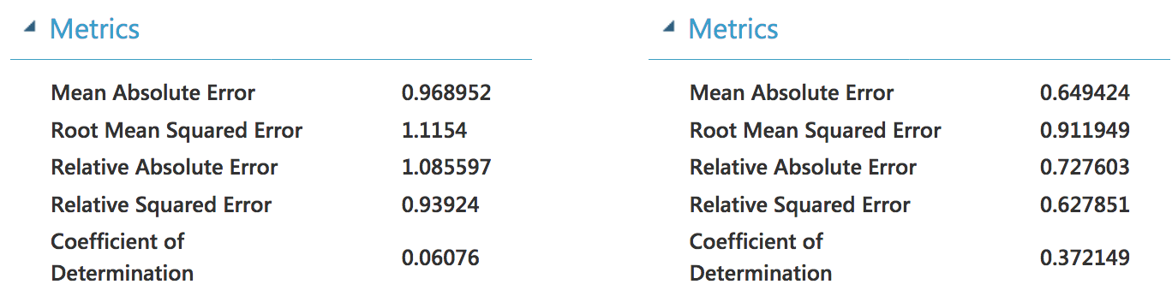
Boosted Decision Tree Regression
Features removed:
marketplace
customer_id
review_id
review_body
Evaluation Metrics
There was no change in Root Mean Squared Error even after removing less weighted features

Slide 22

Comparison
 | Decision Forest Regression | Boosted Decision Tree Regression
Mean Absolute Error | 0.882887 | 0.649424
Root Mean Squared Error | 1.143119 | 0.911949
Relative Absolute Error | 0.989171 | 0.727603
Relative Squared Error | 0.986502 | 0.627851
Coefficient of Determination | 0.013498 | 0.372149

Slide 23
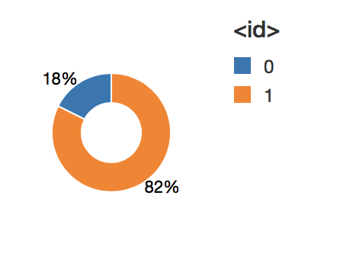
Text Analytics
Analyzing text from “review_head” column to predict the sentiment.
star_rating > 3 means positive sentiment else negative sentiment
70:30 Split Train/Test
Tokenizer splits the review into individual words.
StopWordsRemover removes common words
HashingTF generates numeric vectors from the text values
LogisticRegression algorithm used to train the binary classification model

Slide 24
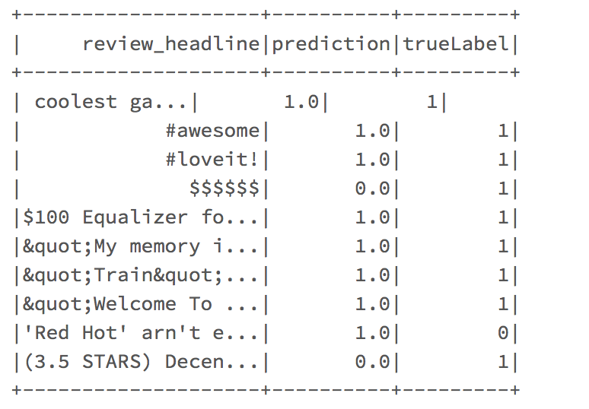
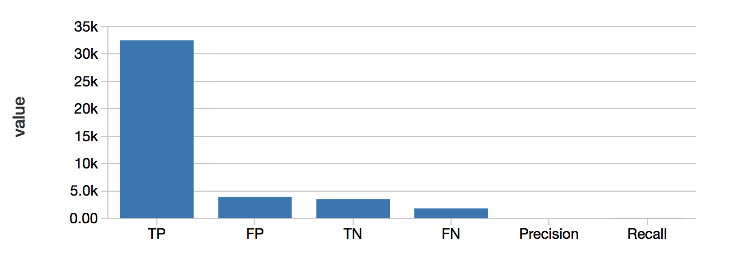
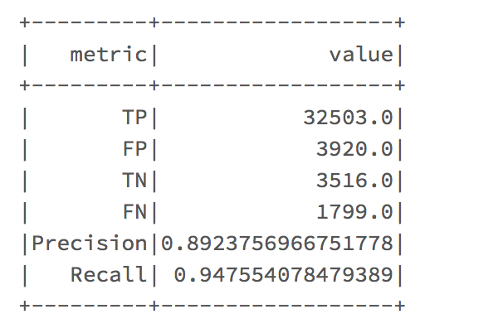
Text Analytics
Time Taken : 4 Minutes
AUR = 0.7101944679648156

Slide 25
CONCLUSION
Azure ML | RMSE | Time Taken
Matchbox Recommender | 1.222147 | 6 Minutes
Decision Forest Regression | 1.143199 | 30 Minutes
Boosted Decision Tree Regression | 0.911949 | 1 Hour 30 Mins
Spark ML | RMSE | Time Taken
Collaborative Filtering | 1.729060 | 30 Minutes
Spark ML | AUR | Time Taken
Text Analytics with Logistic Regression | 0.710194 | 4 Minutes

Slide 26
SUMMARY
Recommendation model is implemented to predict the item recommendation and rating prediction .
It can help in finding customers with the preferred items.
Based on RMSE, for recommendation model, AzureML performed better than the Spark ML.
Boosted Decision Tree performed better than the Decision Forest in rating prediction.
Text Analysis – Helps to understand customer sentiment and satisfaction of a product.

Slide 27

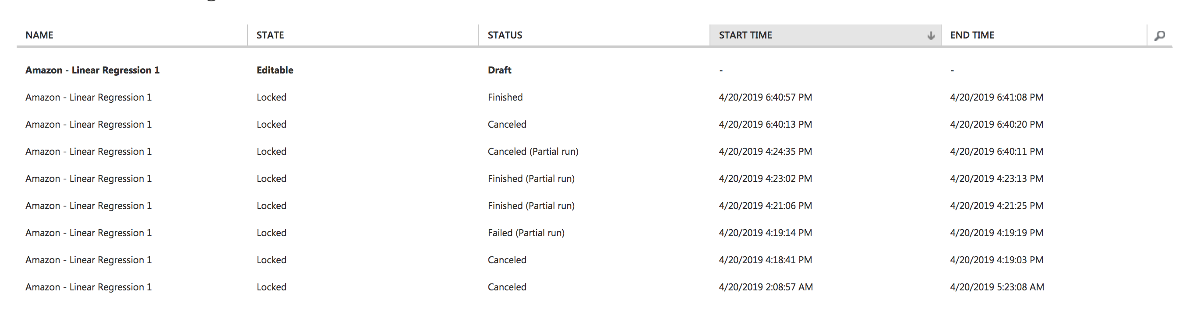
CHALLENGES FACED
AZURE ML
Error 0138: Memory has been exhausted, unable to complete running of module. Process exited with error code -2
Save the experiment under a new name.
Delete the old experiment.
This will release the memory

Slide 28
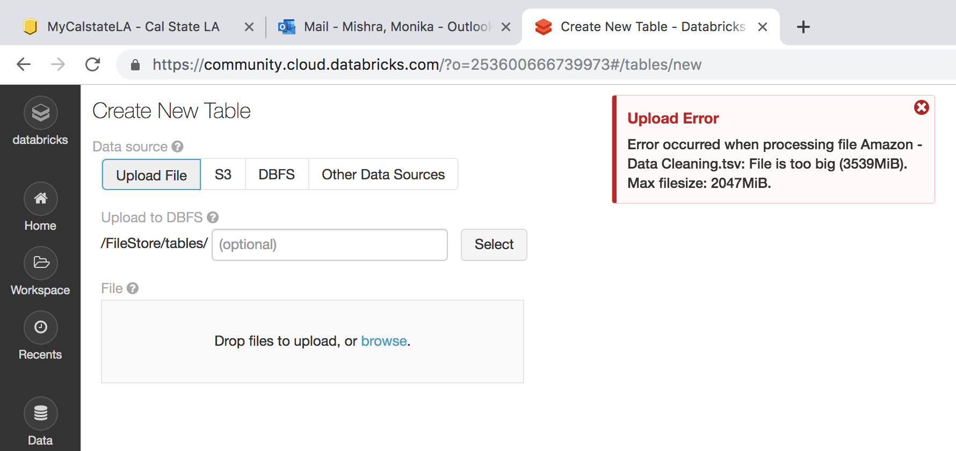
CHALLENGES FACED
SPARK ML
File size lesser than 2 GB will resolve the issue.
The resolution to the spark driver being stopped unexpectedly is unknown.

Slide 29
GITHUB LINK
Github Link :
https://github.com/monika2403/mmishra2/tree/master/CIS%205560

Slide 30
REFERENCES
Microsoft DAT202.3x Implementing Predictive Analytics with Spark in Azure HDInsight
Microsoft's DAT203x, Data Science and Machine Learning Essentials
How to choose algorithms for Microsoft Azure Machine Learning - https://docs.microsoft.com/en-us/azure/machine-learning/machine-learning-algorithm-choice
Databricks Spark Data Engineers -https://docs.microsoft.com/en-us/azure/machine-learning/machine-learning-algorithm-choice

Slide 31
REFERENCES
M. Woolf, “Playing with 80 Million Amazon Product Review Ratings Using Apache Spark,” minimaxir, 02-Jan-2017. [Online]. Available: https://minimaxir.com/2017/01/amazon-spark/.

Slide 32


